Slide 1

Funding Sources for Islamic Microfinance
BY: MUHAMMAD ZUBAIR
CHIEF EXECUTIVE OFFICER
AlHuda Center for Islamic Banking and Economics

Slide 2


Slide 3
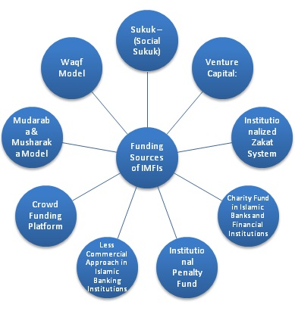
Funding Sources for IMFI’s

Slide 4
Social Sukuk
Sukuk are utilized in the corporate sector for raising the funds for long term financing projects usually for mega and Govt. Infrastructural Development projects
A new term “Social Sukuk” can be devised for such sukuk which can be issued for social development and poverty alleviation projects.

Slide 5

Crowd Funding Technological Platform
An advanced system for transmission of funds to the beneficiaries by linking the microfinance institutions and donors from different areas of the globe.
Crowdfunding platform concept is emerging rapidly and now many IMFI’s are utilizing this concept to secure the fund for Islamic Microfinance.
It can be an alternative tool for securing the funds for Islamic Microfinance.

Slide 6
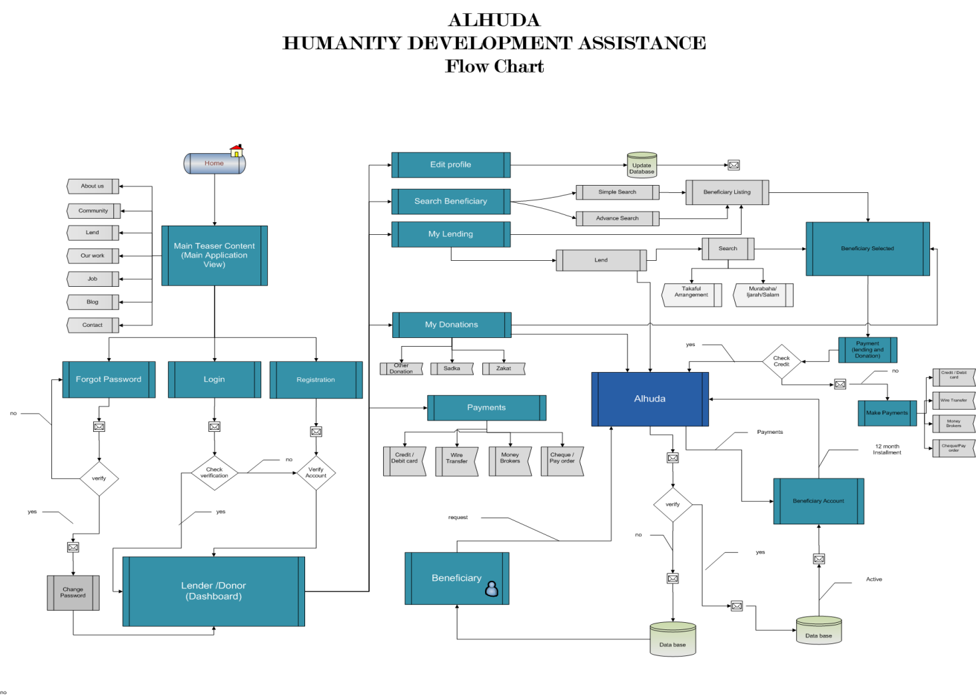
Crowd Funding Platform

Slide 7
Venture Capital and Equity Financing:
Venture Capital is usually utilized to start up, Islamic Microfinance Institutions can also be developed through venture capital in Shariah Compliant manners
Islamic Microfinance institutions can raise their funds through Equity Financing or Venture capital by utilizing Mudaraba or Musharaka mechanism.

Slide 8
Donor Grants, Soft Loans (Qarz-e-Hassan) & Govt. Subsidies
Donor Grants, Soft loans and Govt. Subsidies play a vital role for the development of Microfinance sector, but unfortunately, it is observed that International donor agencies are bit reluctant for Islamic Microfinance
Multilateral donor agencies are taking interest for the promotion of Islamic Microfinance as tool of financial inclusion and social development e.g. Islamic Development Bank, GIZ, USAID, UKAID, IFAD and other agencies. Recently, the Govt. of Pakistan is providing Qarz-e-Hassan (Soft Loans) to Islamic Microfinance institutions as well

Slide 9
Less Commercial Approach in Islamic Banking Industry
Unfortunately, The total share of Islamic Microfinance in Islamic Finance Industry is less then 1%, which is a big question mark as well in Islamic finance Industry
Islamic Finance Market Size: US $ 2.3 trillion
Islamic Banking 82%
Sukuk 11%
Islamic Funds 4%
Islamic Microfinance 1%
Takaful 2%

Slide 10
Charity Funds of Islamic Banks & Financial Institutions
The charity amount collected by Islamic Banks and Financial institutions are huge amount which can be utilized as funding sources of Islamic Microfinance institutions.

Slide 11
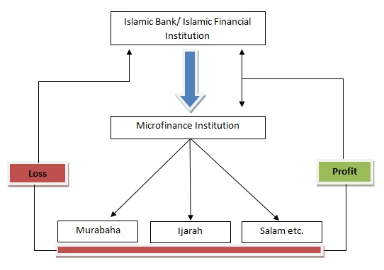
Musharaka Model for Islamic Microfinance Institution

Slide 12
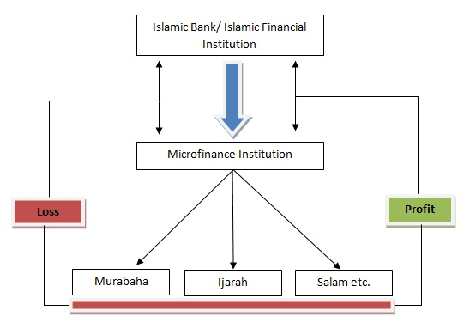
Mudaraba of Islamic Finance Industry

Slide 13
Block chain & Cryptocurrencies
Blockchain & Cryptocurrencies are emerging trends in Fintech arena. Peer to peer network can be utilized for channelizing the money to generate the funding source. It can be utilize as remittance product as well for Islamic Microfinance Industry.

Slide 14
Challenges faced by Islamic Microfinance
Non - Availability of Donor/Shariah Compliant Sources of Funds
Need to develop a uniform regulatory and legal framework for the Islamic Microfinance Institutions.
Accounting & I.T systems., Rating Agencies.
Lack of Quality HR in Islamic Microfinance Sector.
Standardization of Islamic Microfinance Products.
Reluctance in Research & Implementation of new Products, as only (Murabahah) is serving almost 80% of Islamic Microfinance Industry.
Development of Shairah Expertise towards the Growth of Islamic Microfinance.
Policies & Regulations on Zakat & Awqaf.

Slide 15
Opportunities for Islamic Microfinance
Islamic Microfinance Network (IMFN) for an effective interface and Coordination among IMFI’s
Expansion of Market where the Conventional MFI’s face limitations especially in Muslim Majority Countries
AlHuda Centre of Excellence in Islamic Microfinance is offering all Islamic Microfinance Solution.
A Trend in diversion of donors funds to more ethical objectives
IDB - Microfinance Development Program (MDP )
Islamic Banking and Finance is emerging in South Asia, Central Asia & MENA region which will strengthened the Islamic Microfinance effectively.

Slide 16

JazzakAllah
Thank you for listening
Muhammad Zubair Mughal
Chief Executive Officer
AlHuda Centre of Islamic Banking and Economics
Zubair.mughal@alhudacibe.com
www.alhudacibe.com

